Slide 1
Retail Sales Analysis

Slide 2
Table of contents
01
Overview
02
Business Case
03
04
Data Cleaning and preprocessing
Dax
05
06
Insights
Visualize and Design Choices
07
Publication Link

Slide 3
01
Overview
Project Objective: The main objective of this project is to analyze retail sales data to gain actionable insights that will improve business decision-making across customer behavior, product performance, payment preferences, and regional sales dynamics.

Slide 4
02
Description of the dataset
The dataset contains comprehensive retail sales data, including transaction IDs, customer IDs, transaction dates, locations, product categories, payment methods, quantities, pricing, and sales amounts. It enables detailed analysis of customer segments, purchase behaviors, regional performance, product category dominance, and payment trends.

Slide 5
03
Business Case
This project aims to analyze comprehensive retail sales data to uncover actionable insights that support data-driven decision-making across product performance, customer behavior, and sales channels.
By leveraging over 900,000 transaction records—including customer demographics, product categories, regions, payment methods, and purchase channels—the analysis identifies top-performing segments, peak sales periods, and channel efficiencies.
The resulting Power BI dashboard empowers stakeholders to optimize marketing strategies, allocate inventory intelligently, and enhance customer engagement by providing a clear, interactive view of sales trends and performance drivers across the retail business.

Slide 6


Data Preparation & Transformation process

Slide 7
Applied Steps: Column Cleanup: Removed unnecessary columns Reordered columns for logical structure Renamed columns for clarity Null Handling and Filling: Applied Filled Down and Filled Up to propagate missing values Replaced nulls and incorrect values where applicable Calculated Columns: Added multiple Custom Columns for calculated data Inserted Day and Month columns from Date Created conditional fields using IF and Text functions
Data preprocessing steps

Slide 8
Applied Steps: Data Formatting:
Trimmed and cleaned text (removed spaces)
Changed data types (e.g., text, whole number, date)
Promoted headers to use correct column names
De-duplication and Filtering:
Removed duplicate rows
Filtered out irrelevant records
Enhancements:
Duplicated columns for intermediate calculations
Replaced values for standardization (e.g., Date)
Data preprocessing steps

Slide 9
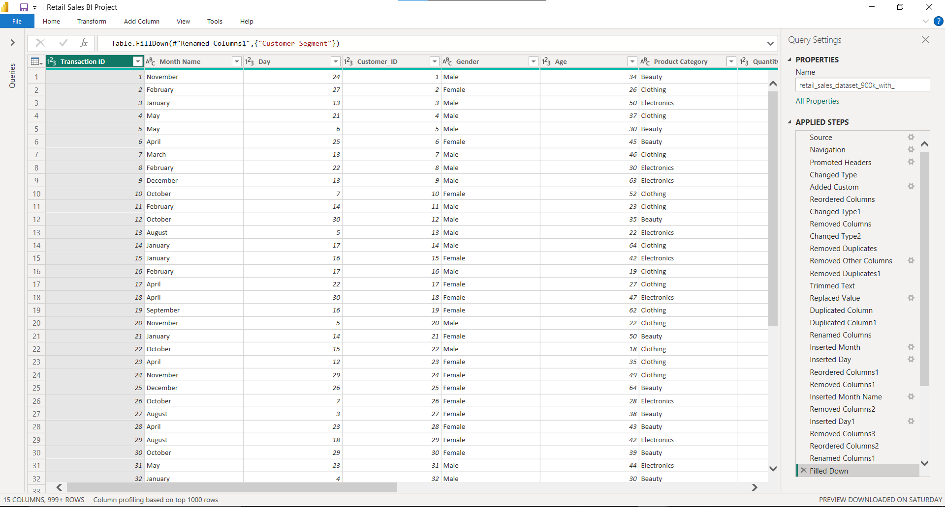

Slide 10
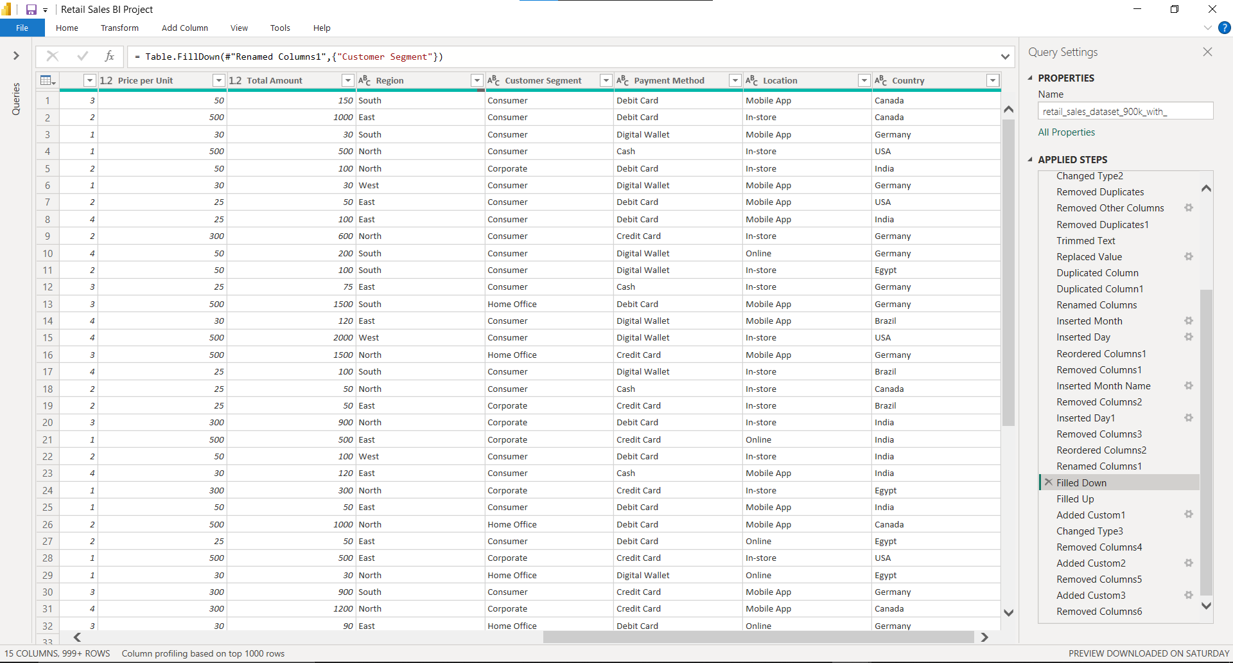

Slide 11

Key DAX measures and calculations

Slide 12
Dax Measures :
Measure | Purpose
Total Sales | Sum of sales amount
Total Quantity | Sum of quantity sold
Total Transactions | Count of all transactions
Top Selling Category | Identify the category with highest total sales
Top Buying Segment | Identify the top customer segment
Top Payment Method | Identify the most used payment method
Top Selling Location | Identify where most sales happen (In-store, Online)
Sales by Gender | Analyze number of transactions by Male/Female
Count of Male and Female Customers | Count unique customers by gender
Top Consumption Region | Identify the region with the highest sales
Top Buying Gender | Find which gender contributes more in purchases
Sales Growth by Month | Analyze sales performance month-over-month

Slide 13
Visuals Types used !

Slide 14
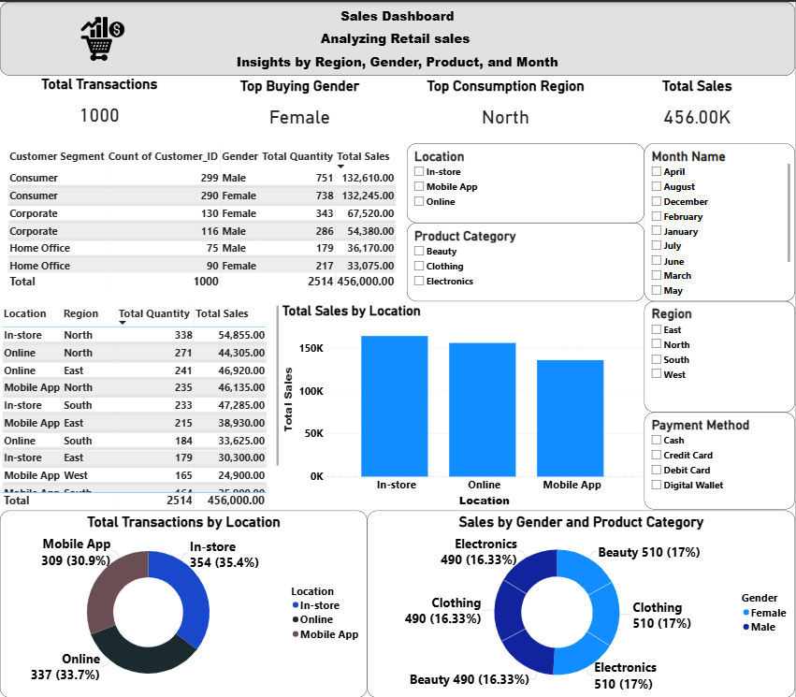

Slide 15
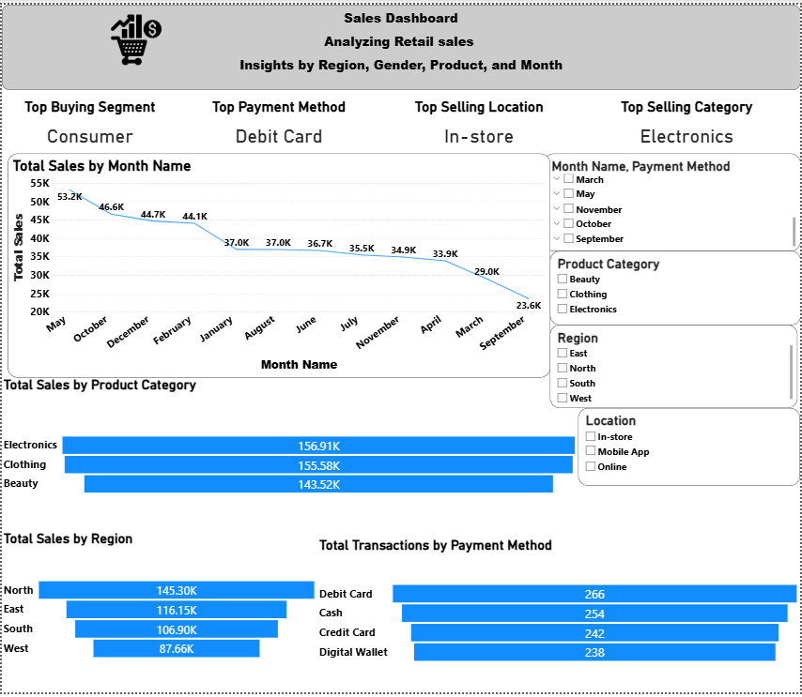

Slide 16
Visualization types
Visual Title | Visual Type | Purpose / Insight
Country and Region | Map | Shows geographical distribution of sales by region (East, West, North, South). Highlights the top-performing area visually.
456.00K – Total Sales | Card | Displays total revenue from all transactions. A high-level KPI.
1000 – Total Transactions | Card | Shows the total number of sales transactions in the dataset.
Female – Top Buying Gender | Card | Identifies which gender contributes most to total sales.
North – Top Consumption Region | Card | Indicates the region with the highest revenue.
Sales by Gender and Category | Pie Chart | Compares number of transactions by gender, split by product category.
Sales by Month Name | Line Chart | Visualizes sales trends over months to identify seasonality or performance dips/spikes.
Customer Segment Table | Table | Shows detailed values per customer segment and gender including quantity and sales. Useful for granular comparison.
Sales by Location Table | Table | Displays total quantity and sales by Location + Region. Helps analyze performance across store types and geography.
Total Sales by Location | Bar Chart | Compares total sales between In-store, Online, and Mobile App locations.

Slide 17
Visualization types
Visual Title | Visual Type | Purpose / Insight
In-store – Top Selling Location | Card | Identifies the most revenue-generating location type.
Debit Card – Top Payment Method | Card | Displays the most commonly used payment type.
Electronics – Top Selling Category | Card | Shows the highest-selling product category.
Consumer – Top Buying Segment | Card | Highlights the customer segment contributing most to sales.
Total Transactions by Location | Donut Chart | Shows percentage of transactions by sales channel (in-store, online, mobile app).
Total Sales by Region | Bar Chart | Compares total revenue across North, East, South, and West regions.
Total Sales vs Quantity by Segment | Scatter Chart | Shows how different customer segments relate in quantity vs. sales – helps assess value vs. volume.
Total Transactions by Payment Method | Funnel Chart | Ranks payment methods based on number of transactions.
Total Sales by Product Category | Bar Chart | Compares how much revenue was generated per product category. Helps identify top product performers.

Slide 18
6
Insights From Analyzing Dashboard

Slide 19
Sales Analysis insights
Area | Insight
Product | Electronics is the top-selling category.
Customer | Consumers are the most profitable segment.
Payment | Debit Card is the most preferred method.
Location | In-store purchases generate the most revenue.
Region | North region leads in overall sales.
Gender | Female customers slightly lead in purchases.
Seasonality | Sales peak in January–March and dip towards September.

Slide 20
7 Publication Link

Slide 21
Click here to view the live Power BI Dashboard

Slide 22
Thank you!
Any Questions?

